Slide 1










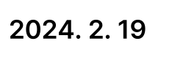

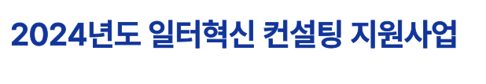
2024H& SAA AAS A elArel
2024. 2.19

Slide 2







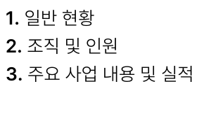
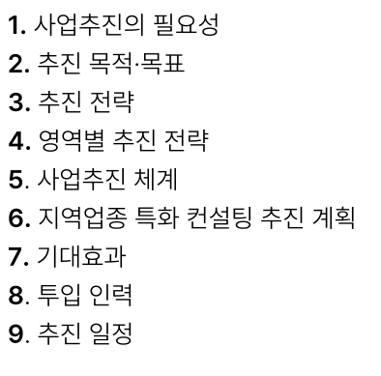
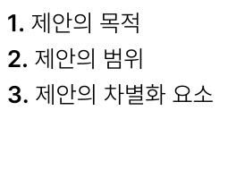



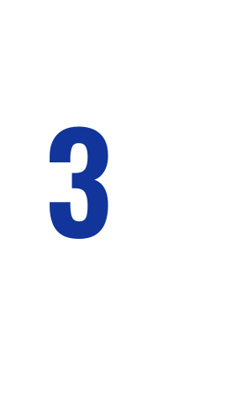




JH At
#2 MlQt us
AIEAE 7H
1, Aloto| SA 2. Aloto| AS 3. Al2to| AP HS} QA
z ral KE m0 bal nr Fal H Reg a it & ul Rr onl x zy Ko or Kl au xp SD KJ K! OF G0 OF Ke KF BO ZK Noto Oo 7. 7|CH2at
‘00 wl x oll on
01

Slide 3










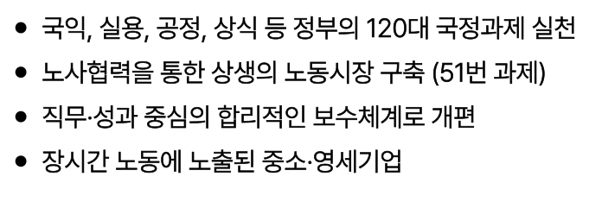


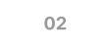
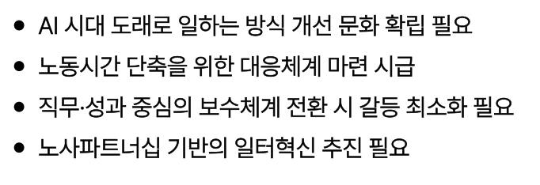
1. Alt HHS
As |= HHS
An e zt : ue 120 os ; = \|Z} = cl SAzh : a a | + FEA AA (51H aA _ MI7IS " | e H Je a oo OW ot oz % iz
Al ACH See? QOS Al 7H St BE] Be SA ESS Ost HSH OF ALS Ala} SAO] ANI] MBE A| ZS AAS} BE SAHPELA 7H] SEAN EA Be Ho
02

Slide 4











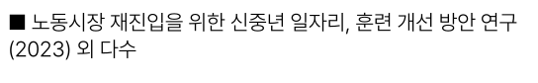



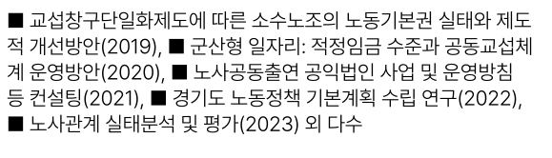


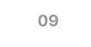

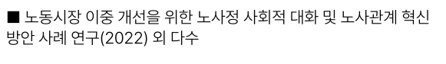



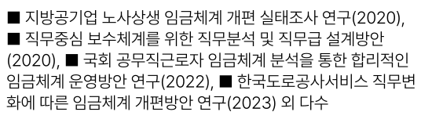

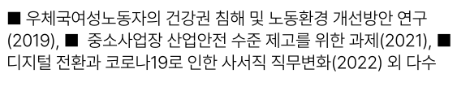

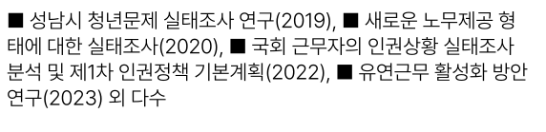
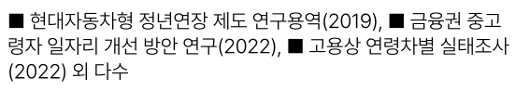

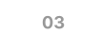

1. Alt HHS
BUSTS Aol OES APA SISA SES A A MASH 2019), Mg Wel: Aes FET SSUGA| Al SSSOH(2020), M HASSSA SAMO! tA BW eSearal S W889 (2021), @ S7Z LSS 7| BAS! +B AT(2022), mA eH SHEA S! B71(2023) 2| Cts
BASS LAs ASAlAl WA SEAL A(2020), BASSY SEAS st ASE 8 ASS salet (2020), @ =3| SPAZEA ASA SAS Sét Helse! SSAA] SSAot AT (2022), MIT LSSAAMH|A ASH S}Ol] CLE AaAl|i| HH Yet A(2023) 2| Cts
SABO} SH] Aa AI (2019), @ SAMA Bek C]A|2 Meta} DSLHOS lt Af.
MC SAS OS AMS St APS APSIAY CHSH BE Le APD] SHA ror ted] S451(2022) 2| Cie
Behl SARA SEHBA AT (2019), BMES SPAS S E}Ol] CHE SLEHZEAL(2020), Ml SS] 2229] Cla sSt SEHAt EA BL MIA AB 7/EAS(2022), FASS S8s} Yor A=7(2023) S| Ct
MSEMS ALS Cot Se Set DAH(2022) 2 Ch-=
#0 = ACHRHSXE & 2: AXt QKfe (2022) | Cts
09
03

Slide 5








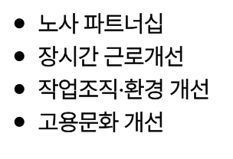



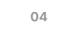

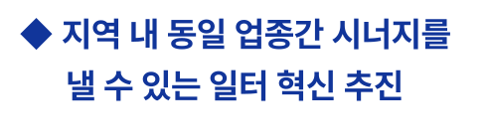
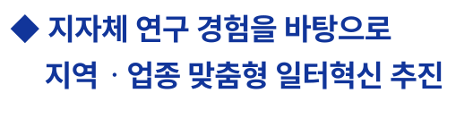
1. Alt HHS
LA YH0| HS QAS|E Hofol] AS
ALAS k nd Kio ry] oll Tt) uy or 5
SAP TELA BAZ Bea FABASS 7H USES 7H
04

Slide 6













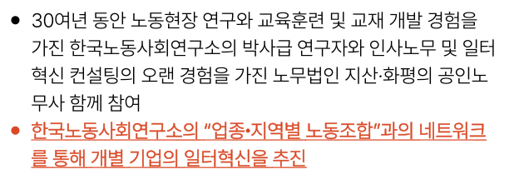





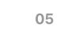


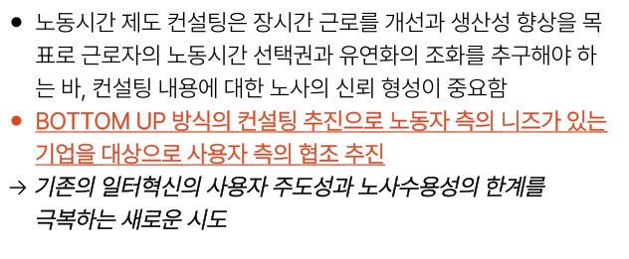

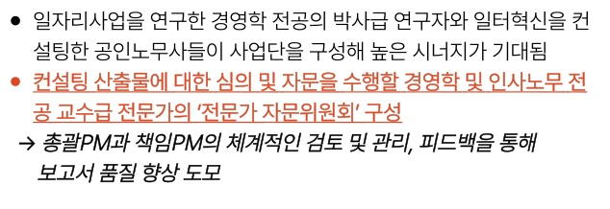
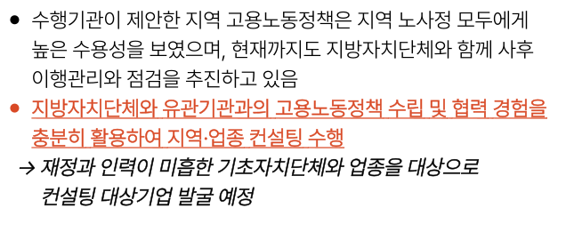
1. Alt HHS
4RUOIZIO| St AIL|A|O} A}oiBHA| AAlO| MEFS}
© 300\4 Set THA Ste SATS] AAS] BE AbES AIAAPSH OlApn SS BL QIE| LSAT Apo Dgee 9B aM Het Be Hel AMES] Set BUS 7H PHO! AIAhSHYO| Bolte BAL aa] B04 ° SIAL SALS| ADA "BETO te SAE} TO| YE ea BEq7 Oo} MYSHAIS AZ
© UNAS ast Aas} AS] Yrs GTA} AAS 2 ABS SUL SASO| MACHS Toy SE AAI7t 7ICHel © AME] ASSOl Clot ALO] BI APES Asst Als} WI MAPS A Ba+e MES HEI} ee els) 2A > SwPMa} AfeIPMo| AIBIO! Ze 3 He), BIB Soy HDA BA Fa eo
AAC SSH eS SHO] BAIS ASS
eo CSAZ AS AAS BAZ SES Ma Ars SS S EE DEO] LSAlZ MEADE FASO] ASHES As oHOF OF = Ub ASME LYSoll Het Ate] Ale] Bo] SQSt © BOTTOM UP #Al9] HAIE! EEO LS} SO! 1/77} BE Z|AS HAS ASA SO] BA BA > ABS SEAHAM ABA ELSI LASSE BAS SSeE MEL AE
© +A | BO] Mlotst AIS DSL SAMS AF LAA 2 O||AI| BE TSSES SUOM, AAMAS ASAI EAS Sta] AE Opastelet AAS FAS US © ASAA CHS Sat | Fito) VSL SBe pel Bl Bel SAS SHS] BolOj 714-1 ASS Say > MBF} 21740] OSE 7|AAPAIEIO} YES HSOe dae Hale a oe
05

Slide 7


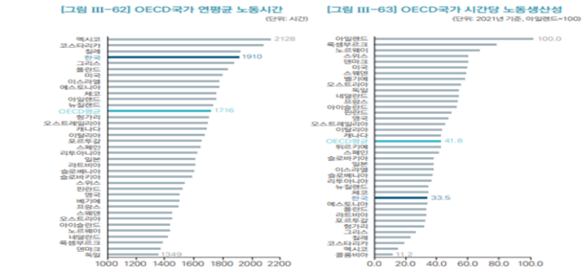






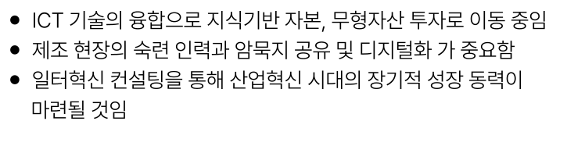
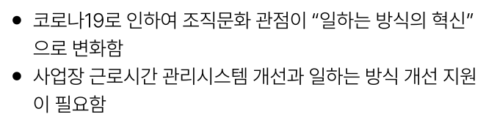
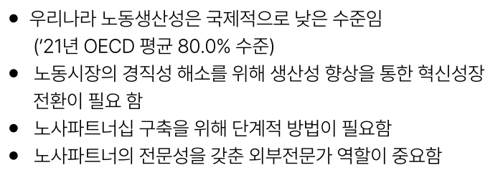
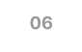



2. $2 AIOE LS
07
ayy
P2|L2} -SUNSS ANAOe HS +A (‘2114 OECD Bt 80.0% +2) TEARS SAS HAS Sloh 4 Ast0| Be ef o cele. MAL Sats Set SAI LAME A PSS oleh CHI eto] Boast LAMIFEL{S] MENS ZHE |S} 1810] SQSt
06

Slide 8





















2. $2 AIOE LS
Bafo| MO StS ts ial | HESS 7355}04 Lo} Ete
RIS Ct9] UEHAl HIE AIS BS
hey or ra ¢ 300 <F
07

Slide 9








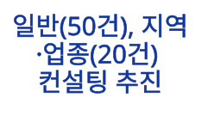
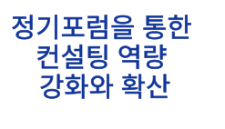
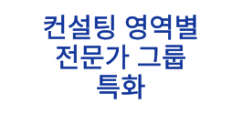

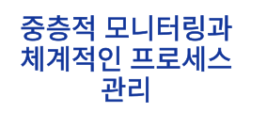
2. $2 AIOE LS
AHHSOZ), AIA -Y3(200) HAE) £2
q7|zee Set HAE] ey 34 2549} Sat
SSA Auaa AAO] BMA #e|
08

Slide 10























2. $2 AIOE LS
7|SAtESIAS|
LASS onze [sp SICH
7|SAtESIAS|
BAL
feb alm eelat $38 SAE We
09

Slide 11




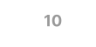










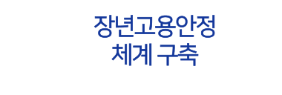

2. $2 AIOE LS
AeA 7H
a sabe neal tz
BP PASE AAS 1O4
AAI SkA~A ts x a) Al
5 Se? | SSAA SS
10

Slide 12





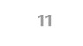
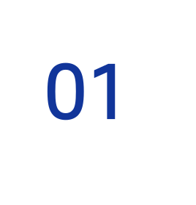

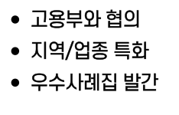




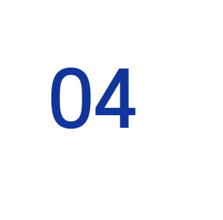

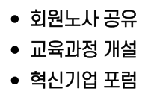
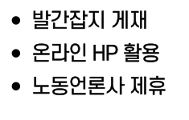
2. $2 AIOE LS
01
02
03
04
Sk fs
WEIS OFls
DHA OAS
ISH 9} HO) eve 3 Sot Ae BZ
SPA BS MSDS Wad sale Bel
$X] HTH iF i? qo ‘alll a Ss bad e SSAEM Hl

Slide 13






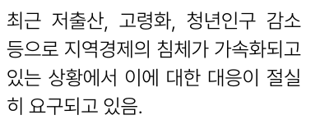
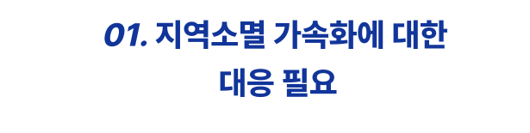
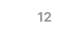
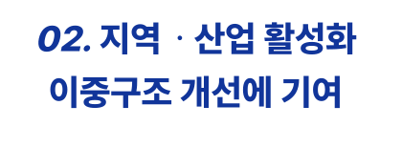
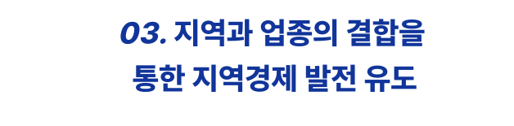

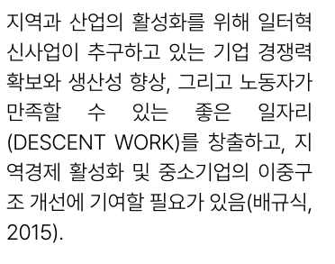


2. $2 AIOE LS
01. AAB 7S Sh0l] Chet tis 22
02.4 - Mei Bast Of SAA AMO] 7104
04, K\AFHI9| S019} B24 AID
AJB MSA, DSS, Aelz zr SOz TAO] Malt 7Ste|D Ql ALBIOIA Olol| CHEE CHO] BAL oi 2712 US.
AAD AAS] SASS HOH VES MAYO] SPOT WE 7IY AHA SHO} MARY SH} e|T Le SXp} wast + Qe S2 arte (DESCENT WORK)= #236}, 2| AAA) SIs} Wt SATA] OST ZA AWMO| 7/O¥St BQ’ US (HAL, 2015).
ASSAM BAS SoHM= ASI SS UG LAS DWeyoyof ofa +, Of7|O] AISQ] Ply-SxAxpHlap S| AS 7|etOw AlSFoHOF St AreH( B)0| AIMS at 7rSetal, Ole A EFAAALAO| XIF-YSOBO| St c=3 of SESSA c=} 25d Feat + Us.
a med lo | BAe] SA SH ABt AIS t, LORE 7IEI7| CHS, tS SASt SMO CHS AISAtS| Of St EA] ERE S7tsok, = SHES Sly DE 74) SoHotet 7tS Stal, & Ss} SSAA = USACE He. bad filet 0x tok bl 2 re tot do U yt Ot ao 10 4y Fr MO pt TIT py 40 wo o 6 Noo BT a 2 OH oO iQ 2 om EJ mio | min 4 r2 Ot re ov be at HI 4 nt 79 ok 2 +0
12

Slide 14











2. $2 AIOE LS
02. KASSS| ASA HO
03. ABADI StAtay AISA] SA
= Ae 17| PISA Was Bz ela SEAL 2 St 7 OF SHH, Ol= AAS Hes FI
QEIHAL AISIAHeO] ABO! Ssh ‘Abt BER NG FS SRO, HMO Ao} S| YOR, AWNOR Sas 7157] of2I71 ZO AE ABNOR sols + lz, o| Ft Ql ACIS WSLS 210] 7a SOV! gl fo} 3 Aloletn #4 We.
SHSA(FS)o] AASMtAse Bel AS. AS SASH] MAS ASASIOA| QTOHS Arte] ASL BSStoy AISAts|ol] 7104SHOF St Che $74! SSS off S7| Heol] 2 SA Ol #8SHE MAS ABot= 20] Sat AA x3 ol@tat + gt 1 49 olo
13

Slide 15








2. $2 AIOE LS
01. AIA, XIAALIA, 1 HAASE B20] THSt polat
03. MES SF - HS} HE Met S HWSO] Bast Hast
a 12 ot 12 Ml S iim = bt mw mz om rio iar |> to 10 & XIE, 1274 ES 3H QE $3 2g SOx dp7| Eo] co] well 1JO{ XIS}-4Sm}S| SH} X/SIoI 2 30| 7tett MAGS te oigoe ft Bert iar 0 fo = me gt MO ye |> 12 ¢o O10
Haas NAGS SAS| SoA AlAlet SA AO] BRsta, MASAO] HStok= APIS, NSS ASA FH, AbASHS| Stat ASAP al at! a asol Sate ewS Ge
Ceer AAAS Sst ASSIS UFAORE 7/Y| 2S Al jo Bao woe So Agate cl fol] CH a1 EAMES Loft sts Mop ola El AO eT Me vy, Ale Loz o HS, ous US, NaS, Sak fF Ie) SATA US, oz]
14

Slide 16








2. $2 AIOE LS
07. 3|4
ASAS Sot AAS 7IBAQE ANY-AS7I2 S| SHS} NSS SHSHAMAAS| SA] Seto s AAAAOF OHH, O13 Flo ASAS7t Betopoj Ce a ish eS Tl fs se sole J2E + Ue.
ASA SS ANSE AA-AS IA -vtags AA S SOA SUAOR YEH QI71| AOA MS 2} FEAUAMS| SUNT ASAS AF/S UTS ANAOS ABSA EZIE|O4OF St. |S Slo O|S AAOpD ASS + WE AA] HE, 71 HEA- AE SE}9|9| Aso] SQS, ih O
IAAS Sst AMIS MAA7IA) SEMA S OY, BEE 7EAISt OfeHztAtS| SHO] HetoHetA Ab ABO| AA] H/ATp Mehol het Sts lo| fe] Hopes BAO| ASHES AAlS|HOF 7/A| PAA SS Ol BSIz} SussS SSAA + UE. Pal
15

Slide 17










2. $2 AIOE LS
02, F2 AAS - Us 3! HASSE Kol oo
03. MBS - 2H SLES
of CHSE AJAY My
16

Slide 18







2. $2 AIOE LS
07. A| Se APBIASI 2] 3]: APES MAAS 5172 BA
02. A|S21Az AAAS As!: BS 177A Chat
* ol Bil Kio ou
04, SAP EIA: SCH eS AIS EAH AWSssslolr S as
72 = o 5 chat O5. XIX, X/EEZEA AIAPN|, [ete SM

Slide 19







2. $2 AIOE LS
02. MEALS! 3! LYS
05. MS Ape St DO] oe
18

Slide 20






2. $2 AIOE LS
19

Slide 21









2. $2 AIOE LS
Bate
02, FAL SA 71s Al] S cho] cia Hey
- 7/Bt 03. Ch 714
ry or 04. 3|
= 202314 Atal A}AH.O4 24 Uae TIRAMOl loFsto 719] SPH 7BLOOH, WHO] Bes Apgioilato] Moy Atz}= 2024L4O}h= 1 A ke me r2 at b> AAA SO] OWS Sojop AHA AUS Aas! oe),
ARAE 2012 MBAS WEZ, Hat Al HEE, OAL, SAHAl, Be SB SUX|AHISH OFA, SEAIAI, SOLA), OFAt Al, SHIA, SBA] S 8 3OCHZHO| CHE Ol XIX] EW 71M PS + HSt SHS ast, A Yole XIHS| Wee, SH, bl AAA, Wes, ety, B22] Sat Hel Clo] APS SBoteell, J E(t Be Yotah VILE BASH SOF ol natn a4 918,
APA Hel 71a
cH9I Ol] RE Ost = nF XO + = o Aoe yost K 81 ENATBAI3| ABZ
20

Slide 22













2. $2 AIOE LS
=r OH jor Kio ry!) 07. 214 -
02. LHO|F AbAt - APH dE, Mees 3 TIATHSA AY
03. MG Mw B! AZIASI +2, IE SB
04, A|4-4s Ss} DS AAI
21

Slide 23




2. $2 AIOE LS
01, DEL AP] AEAP|
03. AI
01. 874 SAS J|ChSst
a3 Ss} ASS JIchSst 02. x14
22

Slide 24




2. $2 AIOE LS
23

Slide 25




2. $2 AIOE LS
24

Slide 26




3. MISHA 27H
25

Slide 27










3. MISHA 27H
26

Slide 28



3. MISHA 27H
27

Slide 29


3. MISHA 27H
28

Slide 30







THANKS FOR WATCHING
AFSELICt F No

